Slide 1
Engineer
Maths in the workplace

Slide 2
How our teaching resources are designed for the classroom

Slide 3
I can understand how maths is used by engineers.

Slide 4
A number is in fractional form when it is displayed as one integer divided by another integer.

Slide 5

Engineer
Precision in engineering
Other applications of maths

Slide 6
Precision in engineering
What do you think engineers do?
Engineers take the principles of science and mathematics and apply them to develop solutions to problems.
They build bridges over rivers and gorges.
They construct tunnels under rivers, seas and cities.
They construct buildings that are sky high in compact spaces.
Fundamentally, they solve problems for humanity. Problem solving is the very essence of mathematics.

Slide 7
Precision in engineering
A key aspect of any work carried out by engineers is precision. If they are not precise, the bridge falls down, the building collapses, or the plane falls out of the sky.
Look at your ruler. What are these tiny, precise measurements in between each centimetre?
They are millimetres and there are ten millimetres in one centimetre.
0
cm
1
2
3

Slide 8
Precision in engineering
Millimetres and centimetres are metric measurements.
Turn your ruler around.
What does the ‘in’ stand for and to what family of measures does it belong?
‘in’ stands for inches, an imperial measurement. Historically in the UK we used the imperial measurement system.
0
in
1
2
3

Slide 9
Precision in engineering
What do you think we call these small, precise measurements in between the inches?
No. It’s not milli-inches!
They don’t have a name. They are described as fractions of an inch.
0
in
1
2
3

Slide 10


Precision in engineering
0
in
1
2
3
“Half an inch”
“A quarter inch”

Slide 11



Precision in engineering
What would we call these measures?
0
in
1
2
3
“One eighth of an inch”
“Half an inch”
“Three quarters of an inch”
“A quarter inch”
“Seven eighths of an inch”

Slide 12

Precision in engineering
You might find a ruler even more precise than this one.
What do you think this new fraction is?
0
in
1
2
3
One sixteenth of an inch is about as accurate as can be cut by human hand so old rulers were rarely more accurate than this.

Slide 13
Precision in engineering
What do you notice about the denominators of the fractions?
2, 4, 8 and 16 are all powers of 2
0
in
1
2
3
This is deliberate because half of a half is a quarter, half of a quarter is an eighth, and half of an eighth is one sixteenth.

Slide 14
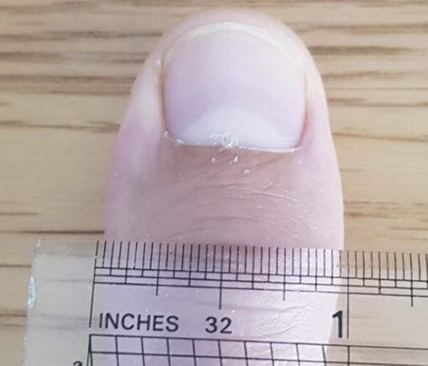
Precision in engineering
2, 4, 8 and 16 are all powers of 2
These powers of two, combined with one other key fact, allowed early engineers to accurately communicate with one another.
0
in
1
2
3
At its widest point, an adult thumb is approximately one inch in diameter.

Slide 15

Precision in engineering
0
in
1
2
3
a quarter
Half of a half is __________.
Half of __________ is one sixteenth.
one eighth
Half of one sixteenth is __________.

Slide 16
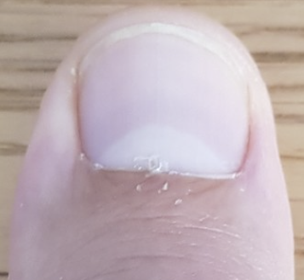
Precision in engineering
This length is approximately __________ long.
four inches
two and a half inches
This length is approximately __________ long.

Slide 17




Precision in engineering
This rule of thumb enabled engineers in the UK to measure, cut and communicate to a good degree of precision.
1
2
We can measure a precise length like one and five eighths of an inch.

Slide 18



Precision in engineering
Measure out two and one eighth of an inch.
2
3

Slide 19
Precision in engineering
For longer measurements carpenters used to carry another interesting tool.
A five foot folding rule. This was also known as a Carpenter’s Rule or a Mason’s Rule.

Slide 20
Precision in engineering
This length is four feet long.
This length is two and a half feet long. Or, two foot six inches. (There are 12 inches in one foot)

Slide 21
Precision in engineering
five foot
This is a __________ folding rule.
twelve inches
There are __________ in a foot.

Slide 22
Precision in engineering
Measuring in feet and inches and being accurate to within one sixteenth of an inch was fine for the challenges of the past. Buildings only a few stories high still stand if built to this level of precision.
However, today we build skyscrapers almost a kilometre tall, bridges that suspend a million tons of load, and jets and rockets which travel at almost 1000 mph. These modern demands mean that a sixteenth of an inch will not suffice. Engineers’ levels of precision today have to be far more accurate than that.

Slide 23
Precision in engineering
You can see on your ruler that one millimetre is smaller than a sixteenth of an inch. That makes it a more accurate measure to use. However, that is still not accurate enough for modern day engineering challenges.
0
in
1
0
cm
1
2
3
Do you know any metric measures of length smaller than one millimetre?

Slide 24
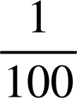
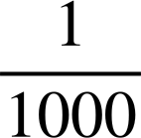
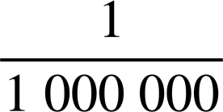
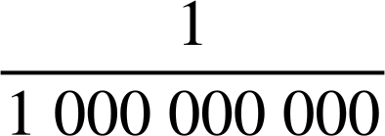
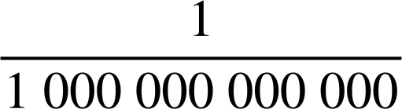
Precision in engineering
One metre
One centimetre
m
One millimetre
m
Laser cutting technology means modern engineers can cut to within 25 microns (micrometres) in accuracy.
One micrometre
m
One nanometre
m
An atom is about 100 picometres in diameter.
One picometre
m

Slide 25
Precision in engineering
Engineers describe these measures in standard form.
One centimetre
m
1 × 10⁻² m
One millimetre
m
1 × 10⁻³ m
One micrometre
m
1 × 10⁻⁶ m
One nanometre
m
One picometre
m

Slide 26
Precision in engineering
Engineers describe these measures in standard form.
One centimetre
m
1 × 10⁻² m
One millimetre
m
1 × 10⁻³ m
One micrometre
m
1 × 10⁻⁶ m
One nanometre
m
1 × 10⁻⁹ m
One picometre
m
1 × 10⁻¹² m

Slide 27

Precision in engineering
Engineers can use laser cutting devices to be precise to within 25 microns. What is this in standard form?
One micron (micrometre) = 1 × 10⁻⁶ m
25 × 10⁻⁶ m
By using the standardised international (SI) unit of metric measure (the metre) and the global language of mathematics (standard form) engineers all over the world can now accurately communicate with one another.
2.5 × 10⁻⁵ m
2.5 × 100⁻⁶ m

Slide 28
Precision in engineering
1) Read these measures.
a)
0
in
1
2
3
b)
0
in
1
2
3
c)
0
in
1
2
3

Slide 29
Precision in engineering
2) Use a rule of thumb to measure out the below:
a) One and three eighths of an inch.
b) Two and three sixteenths of an inch.

Slide 30
Precision in engineering
3) a) How many millimetres in a centimetre?
One centimetre
m
1 × 10⁻² m
One millimetre
m
1 × 10⁻³ m
b) How many micrometres in a millimetre?
One micrometre
m
1 × 10⁻⁶ m
c) How many micrometres in a centimetre?
d) Engineers can laser cut to a precision of 2.5 × 10⁻⁵ m
What fraction of a centimetre is this?

Slide 31

Precision in engineering
1) Read these measures.
inches
a)
inches
0
in
1
2
3
b)
inches
0
in
1
2
3
c)
0
in
1
2
3

Slide 32
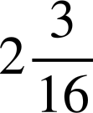

Precision in engineering
2) Use a rule of thumb to measure out the below:
a) One and three eighths of an inch.
b) Two and three sixteenths of an inch.
1
2
2
3

Slide 33
Precision in engineering
3) a) How many millimetres in a centimetre?
3) a) How many millimetres in a centimetre?
One centimetre
m
1 × 10⁻² m
10
One millimetre
m
1 × 10⁻³ m
b) How many micrometres in a millimetre?
One micrometre
m
1 × 10⁻⁶ m
(1 × 10⁻³) ÷ (1 × 10⁻⁶) = 1000
c) How many micrometres in a centimetre?
(1 × 10⁻²) ÷ (1 × 10⁻⁶) = 10 000

Slide 34
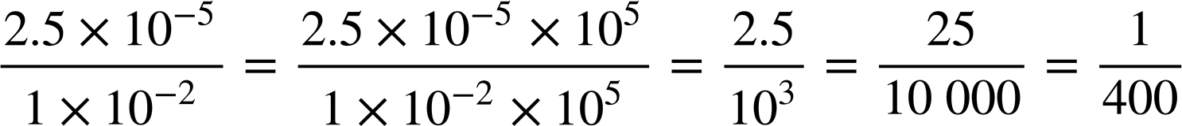
Precision in engineering
3)
One centimetre
m
1 × 10⁻² m
One millimetre
m
1 × 10⁻³ m
One micrometre
m
1 × 10⁻⁶ m
d) Engineers can laser cut to a precision of 2.5 × 10⁻⁵ m
What fraction of a centimetre is this?
Can you imagine one four-hundredth of a centimetre! This is the kind of precision engineers operate to.

Slide 35
Engineer
Precision in engineering
Other applications of maths

Slide 36
Other applications of maths
A Mason’s Rule was often a five-foot folding rule. Not four, not six. Five. This was for a reason.

Slide 37
Other applications of maths
When building a wall, early in the process, a mason would measure three feet up the wall, and four feet from the base.
They would then see if the five foot rule ‘fitted’.
Why do you think they did this?
3 ft
4 ft

Slide 38
Other applications of maths
This is Pythagoras’ theorem in action!
3² + 4² = 5², a Pythagorean triplet.
This shows that this is a right-angled triangle. More importantly, the wall is being built perfectly upright!
5 ft
3 ft
4 ft

Slide 39
Other applications of maths
If the wall were not ‘right’, the five-foot rule would not fit.
The rule needs to meet with both the point at 4 ft from the base and the point at 3 ft up the wall in order to make a 3, 4, 5, right-angled triangle.
✖
3 ft
✖
4 ft

Slide 40
Other applications of maths
These bricks are being laid at the corner of a new building.
How do we know the two walls are not perfectly perpendicular?
5 ft
You might have said, “The rule does not ‘fit’ to make a 3, 4, 5, right triangle so we know the corner is not a right angle”.
3 ft
4 ft

Slide 41
Other applications of maths
Ancient Egyptian engineers used to make a 3, 4, 5 triangle out of rope marked out by knots.
When they pulled the triangle tight, they knew they had a perfect right angle.
Do you think they used feet?
5 ft
The Ancient Egyptians predate ‘feet’ by thousands of years but, so long as you use the same unit of measure between knots, the rope works.
3 ft
4 ft

Slide 42
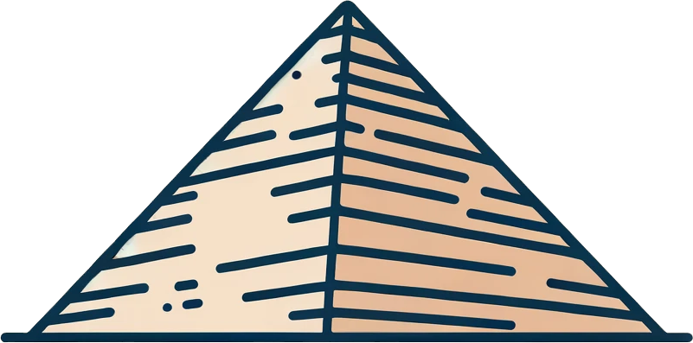
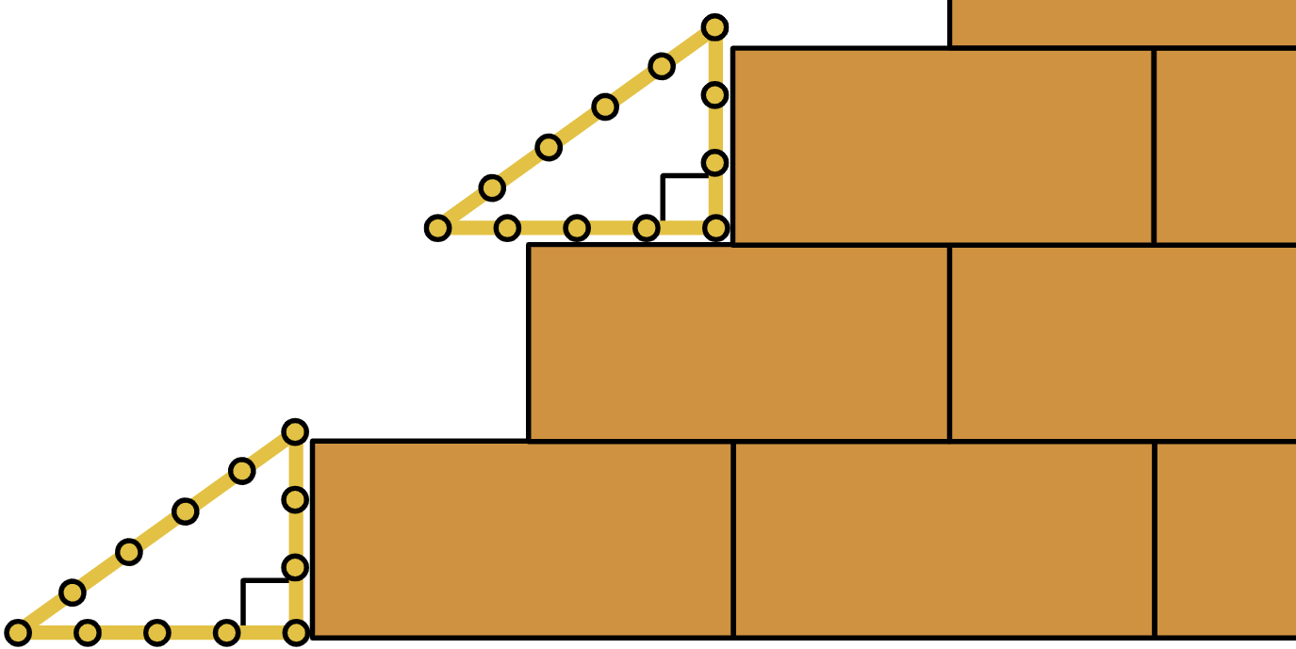
Other applications of maths
Ancient Egyptian engineers were the first great builders in human history. They used 3, 4, 5 triangles to check that everything was ‘right’ as they built.
Interestingly they were doing this two thousand years before Pythagoras was even born!

Slide 43


Other applications of maths
Which of these ropes could the Egyptians have used to check that things are ‘right’?
6² + 8² = 10²
a
3² + 4² = 5²
4² + 5² ≠ 6²
Not a ‘right’ triangle.
c
b

Slide 44
Other applications of maths
Ancient Egyptian engineers (and many since!) used 3, 4, 5 triangles because this the smallest triplet, therefore the most efficient to make.
a
3² + 4² = 5²
Why don’t you get some string and make your own 3, 4, 5 triangle to check that things are ‘right’ in your classroom or house? You don’t have to use feet, you could make a 3 inch, 4 inch, 5 inch triangle. If you do this you’ll be behaving like the earliest great engineers in human history!

Slide 45
Other applications of maths
1) Show whether each of these walls is upright.
a)
b)
c)
50 cm
40 cm
13 yd
12 yd
5 ft
4 ft
30 cm
3 ft
5 yd

Slide 46
Other applications of maths
2) Explain how we know this corner is not ‘right’.
5 ft
3 ft
4 ft

Slide 47
Other applications of maths
3) Engineers today use Pythagoras to calculate lengths. Find all the missing lengths of the girders on this bridge. The design is symmetrical.
10 m
48 m
15 m
9 m

Slide 48
Other applications of maths
1) Show whether each of these walls is upright.
a)
b)
c)
5² + 12² = 13²
3² + 4² = 5²
50 cm
40 cm
13 yd
12 yd
5 ft
4 ft
Right
Right
Right
30 cm
3 ft
30² + 40² = 50²
5 yd

Slide 49
Other applications of maths
2) Explain how we know this corner is not ‘right’.
You might have said, “In order to be ‘right’ the Mason’s Rule should ‘fit’ to the points measured at 3 ft and 4 ft to make a ‘right’ 3, 4, 5 triangle”.
✖
“Because the rule does not ‘fit’ here we know the third length is not 5 ft therefore this is not a right-angled triangle; the corner is not a right angle.”
5 ft
✖
3 ft
4 ft

Slide 50



Other applications of maths
3) Engineers today use Pythagoras to calculate lengths. Find all the missing lengths of the girders on this bridge. The design is symmetrical.
24 m
10 m
26 m
26 m
48 m
15 m
32.3 m
15 m
12 m
12 m
12 m
12 m
32.3 m
9 m
30 m
9 m

Slide 51
Engineer
We have seen some of the ways in which maths is used by engineers.
We understand the need for precision and that engineers use standard form to communicate really precise numbers.
We know that for thousands of years engineers have used Pythagoras’ theorem to check for right and non-right angles in their work.

Slide 52

© Oak National Academy 2024.
Produced in partnership with Mathematics in Education and Industry.
Licensed on the Open Government Licence v3.0, except where otherwise stated. See Oak terms and conditions.

